Slide 1
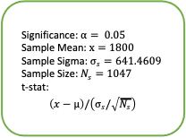
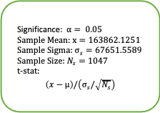
Significance: $α= 0.05$
Sample Mean: $\overline{x}=163862.1251$
Sample Sigma: $σ_{s}=67651.5589$
Sample Size: $N_{s}=1047$
t-stat:
$$\left(\overline{x}−μ\right)/\left(σ_{s}/\sqrt{N_{s}}\right)$$
Significance: $α= 0.05$
Sample Mean: $\overline{x}=1800$
Sample Sigma: $σ_{s}=641.4609$
Sample Size: $N_{s}=1047$
t-stat:
$$\left(\overline{x}−μ\right)/\left(σ_{s}/\sqrt{N_{s}}\right)$$
Conducting right sided hypothesis testing with the given data. Using t-statistic as we do not know the population standard deviation.
t_score = 6.6301
p = 0.000000000027
t-stats

Slide 2
# Prediction Interval --------------- Reference: https://online.stat.psu.edu/stat501/lesson/3/3.3
x=data["Advertising Expense"]
x_mean=data["Advertising Expense"].mean()
y=data["Revenue - Total"]
n=data["Advertising Expense"].count()
#calculate standard error of the mean
s=st.sem(y)
SSx=sum((x-x_mean)**2)
tαby2 =2.069
α = 0.025 #95% prediction interval
df=n-1
x1=1500
β0=intercept
β1=slope
ŷ=round((β0+β1*x1),2)
u_interval=ŷ+(tαby2*s*math.sqrt(1+(1/n)+((x1-x_mean)**2)/SSx))
l_interval=ŷ-(tαby2*s*math.sqrt(1+(1/n)+((x1-x_mean)**2)/SSx))

